Slide 1

Type Racing

Slide 2

Our team members
Name - Last name : Sahapat Poomunna
Student ID : 623040394-7
Date / Month / Year of Birth: 24/07/2000
Bachelor Degrees: Studying bachelor degree of Digital Media Engineering
University: Khon Kaen University
Address: 240, Moo.15, Dong Kilek Village, Som Rong Sub-district, Sisaket, Thailand, 33120
Mobile: 098-097-7883
Email: sahapatpoomunna@kkumail.com
Name-Last name: Mr.Sirapong Tilokkul
Student ID: 623040198-7
Date / Month / Year of Birth: 22/02/2001
Bachelor Degrees: Studying bachelor degree of Digital Media Engineering
University: Khon Kaen University
Address: 1773/92 Tor.pattana RD, Thatchoengchum, Muang SakonNakhon 47000
Mobile: 093-428-8181
E-mail: sirapong.tilokkul@kkumail.com
Name - Last name: Sahatsawat Rimphongern
Student ID: 623040199-5
Date/Month/Year of Birth: 28/12/2000 Bachelor Degrees: Studying bachelor degree of Digital Media Engineering
University: Khon Kaen University
Address: 238 M.1, Mittraphap Rd, Samran, Khon Kaen, Khon Kaen, 40000
Mobile: 081-2337733
Email: sahatsawat_rimpg@kkumail.com

Slide 3
Motivation
Nowadays, typing skill is very important when we need to finish a job or assignment on time. Therefore, we would like to develop this game for everybody who want to improve typing skill. We want to solve the main problem. So, we need to make this game to access the user’s typing skill and improve their typing skill.

Slide 4
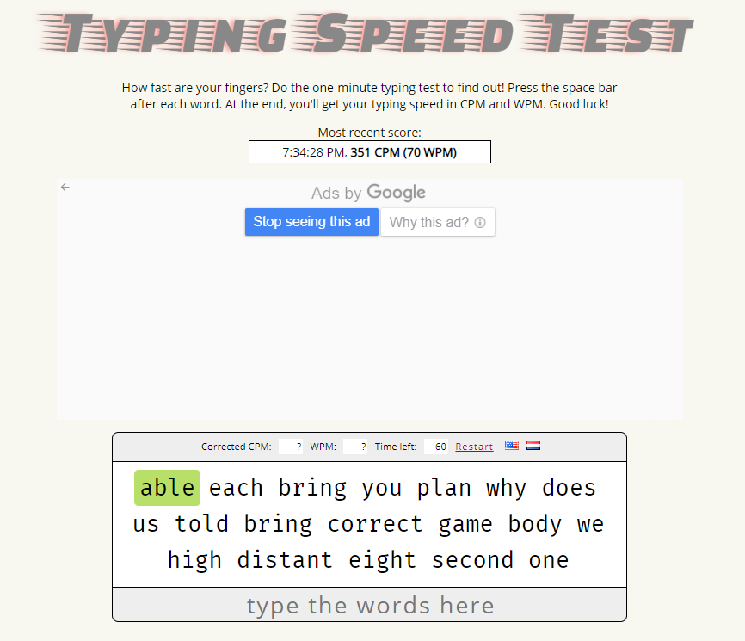
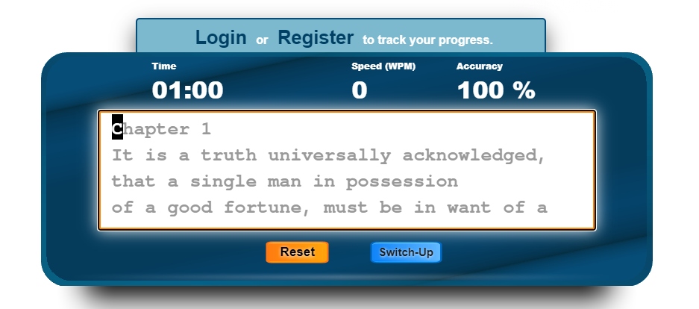
Related games

Slide 5
Methodology

Slide 6
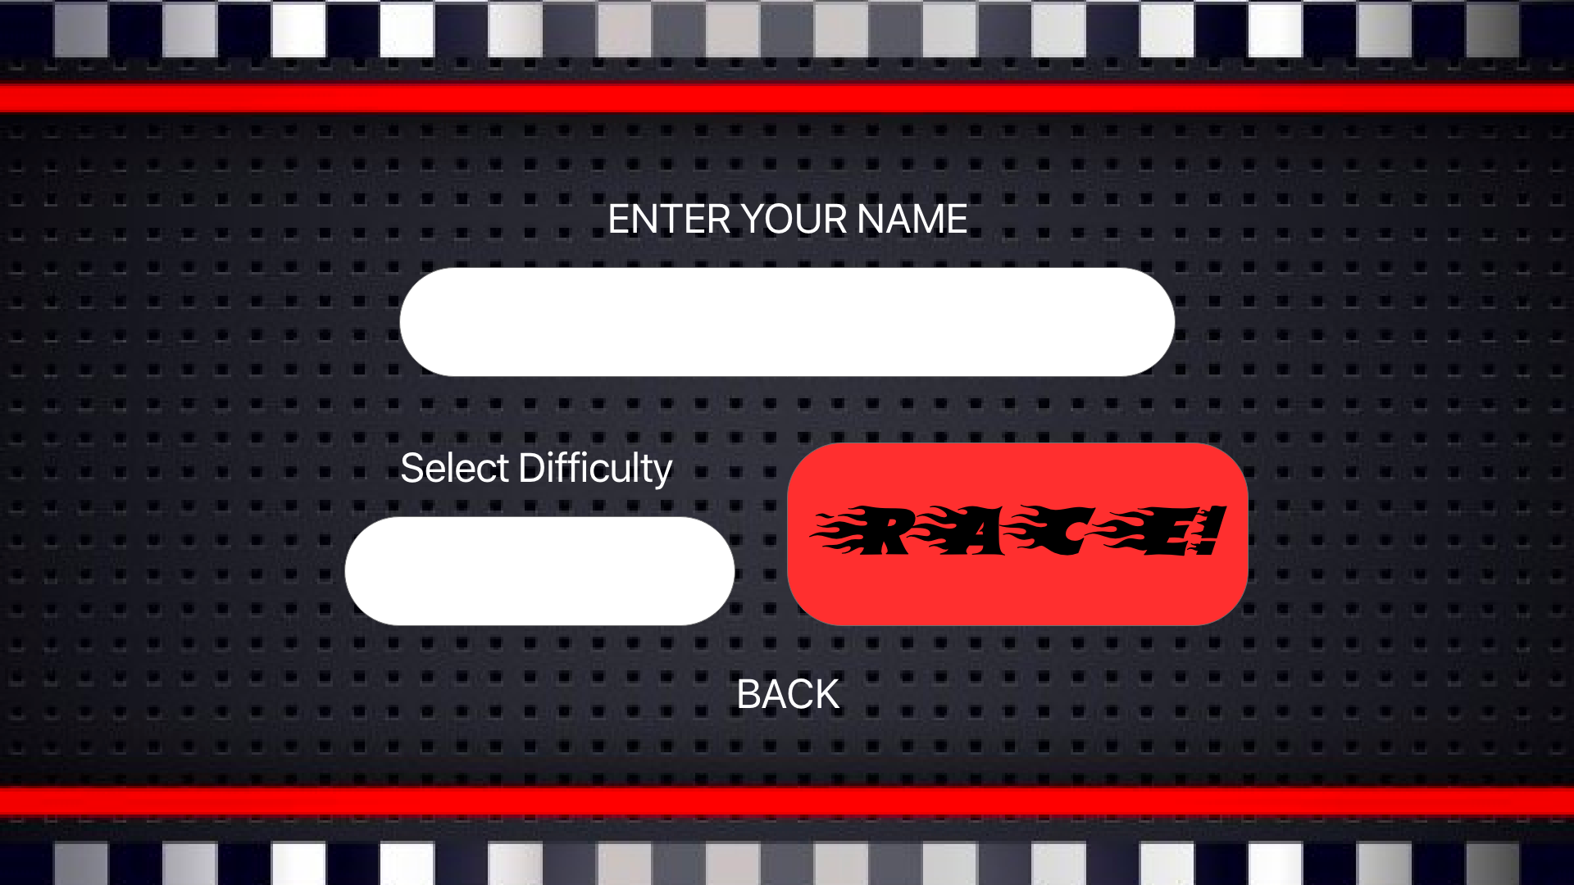

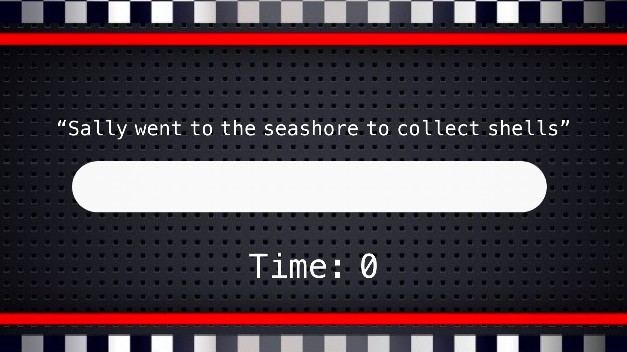
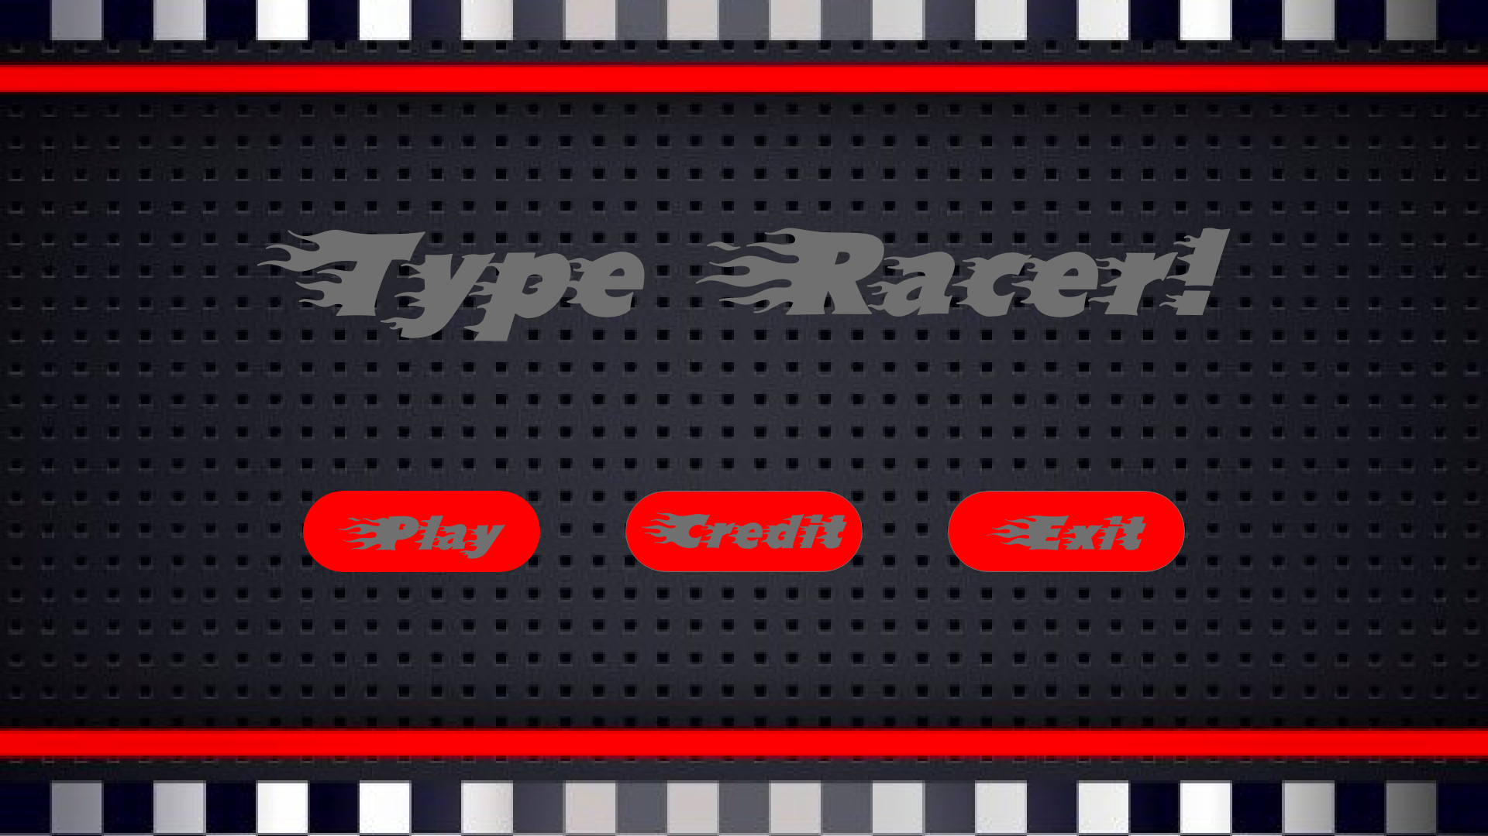

Interface

Slide 7
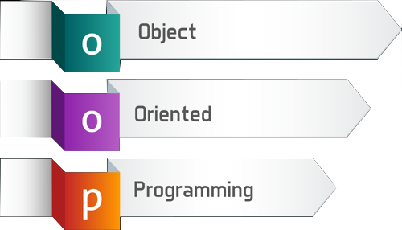

Technology

Slide 8



Tools

Slide 9
Object oriented design
Input
- User’s keyboard input
- API random sentences
Output
Score
Speed of your typing skill
Function
Measure speed of your typing skill
Scoreboard

Slide 10




Software Architecture
Tkinter
User’s input
API
Program
Display screen

Slide 11
Conclusions
Now
- Membership
- Scoreboard
- Typing game
- Count in seconds
Future
- Use API for random sentences
- Count by word per minutes
Develop UI, UX
Insert more function

Slide 12
Thank You

